Slide 1




Hybrid IRCTC Bot-Detection and Train Search Web App
Hybrid human verification and demand-aware train search with confirmation probabilities.
Subradeep Das | PRN: 250304323001
Course: Advanced Certificate in HPC-AI, CDAC CINE
Supervisor: Mr. David Ray (Project Engineer)
Session: Mar 2025 – Aug 2025 | Date: 11/08/2025

Slide 2
Introduction
Building a hybrid bot-detection and train-search system for IRCTC-like workflows that is fair, fast, and privacy-preserving.
Fewer scalper bots, clearer confirmation odds, smoother Tatkal rush.
Context: Peak-hour ticket rush, bot abuse, and low visibility into confirmation odds.
Approach: CAPTCHA + behavioral biometrics; demand and punctuality insights; confirmation probability model.
Focus: Low-latency architecture, privacy-preserving telemetry, and easy deployability.

Slide 3
Problem Statement
Bots distort fairness and overwhelm peak‑hour capacity, degrading user experience.
Users lack clear, calibrated confirmation odds before booking, leading to poor choices.
Operations require auditable, low‑latency models with real‑time monitoring and rollback.

Slide 4
Objectives
Hybrid verification: CAPTCHA + behavioral signals to classify human, bot, and human‑like bot with calibrated thresholds.
Fast train search: integrates punctuality, inferred demand, and calibrated confirmation probability for decisions.
Privacy‑first telemetry with automated retraining and acceptance tests before deploy.
Production readiness: reliability, observability, rollback, and auditability with clear runbooks.

Slide 5
Scope
In‑scope: login verification, behavioral signals, bot/human classification, train search UI, calibrated confirmation probability, demand heat maps, admin dashboard, logs, and auto‑retraining pipelines.
Out‑of‑scope: payments, live booking, official IRCTC integration, and OTP/payment flows

Slide 6
Tools & Tech Used
Backend: Flask (Jinja2 templating), session cookies, JSON APIs.
ML: TensorFlow/Keras (bot detector .h5), scikit‑learn (StandardScaler, train/val split), joblib artifacts, periodic on the fly retraining.
Data/Storage: CSV logs (login_attempts.csv, debug_predictions.log), local CSV datasets (train_search_dataset.csv), model dir with scaler/model; optional JSON payloads.
Ops: Gunicorn + Nginx (target deployment), Docker-ready, environment variables for secrets/paths, debug toggle, scheduled retraining, rate limiting/WAF in front (Nginx).
Dev: Python 3.10, Pandas, Pillow (CAPTCHA), Matplotlib (PNG chart via Agg), Poppins/DejaVu fonts, calendar/datetime utilities.

Slide 7
System Design (Architecture)
Frontend: Login + search UI, CAPTCHA image endpoint, station suggestions, results page.
Auth Gateway: CAPTCHA verification + privacy‑first behavioral telemetry capture.
Bot Detection Service: TensorFlow/Keras model with scikit‑learn scaler; hybrid rules; online retraining.
Search/Prediction Service: Pandas filtering, deduping, soft ranking; calibrated confirmation probability surface.
Data Layer: CSV datasets and logs (audit trails, retraining history, model artifacts).
Admin & Ops: Retraining trigger, model promotion/rollback, debug logs, metrics.

Slide 8
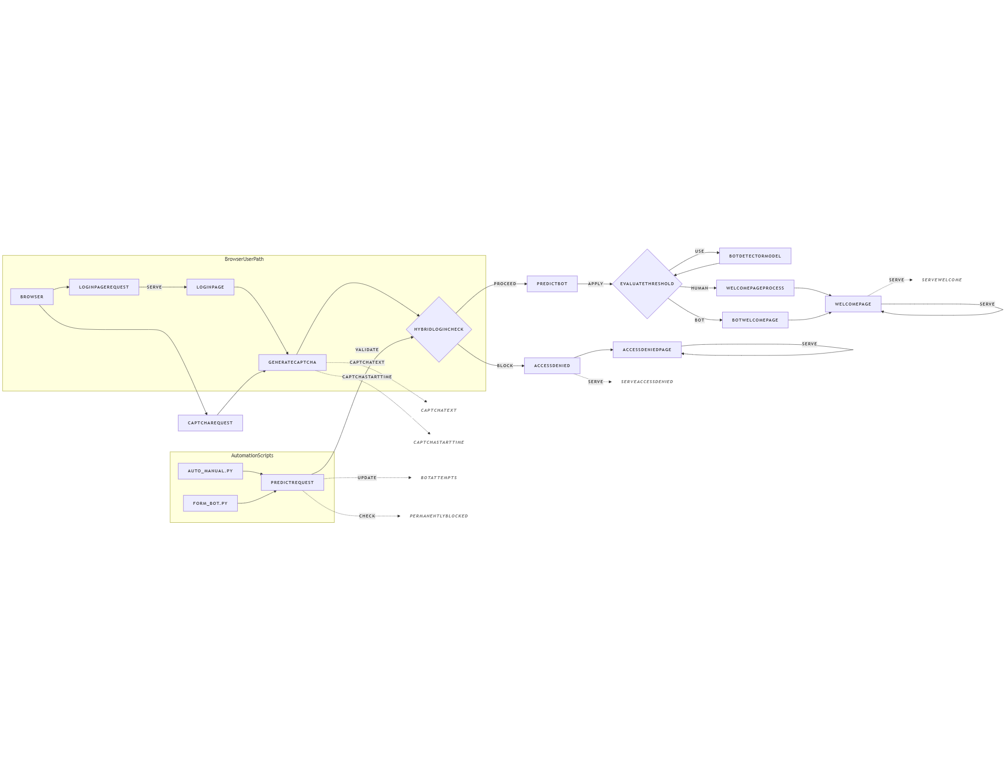
Architecture Diagram

Slide 9
Implementation
Behavioral signals: mouse curvature/velocity, keystroke intervals, scroll cadence, focus/blur, idle streaks, CAPTCHA timings.
Models: Keras DNN/1D‑CNN for behavior; decision layer with hybrid rules; probability output with calibration monitoring.
Retraining: policy‑gated; promote only if val_loss↓ and acc/AUC↑; auto backup + metadata

Slide 10
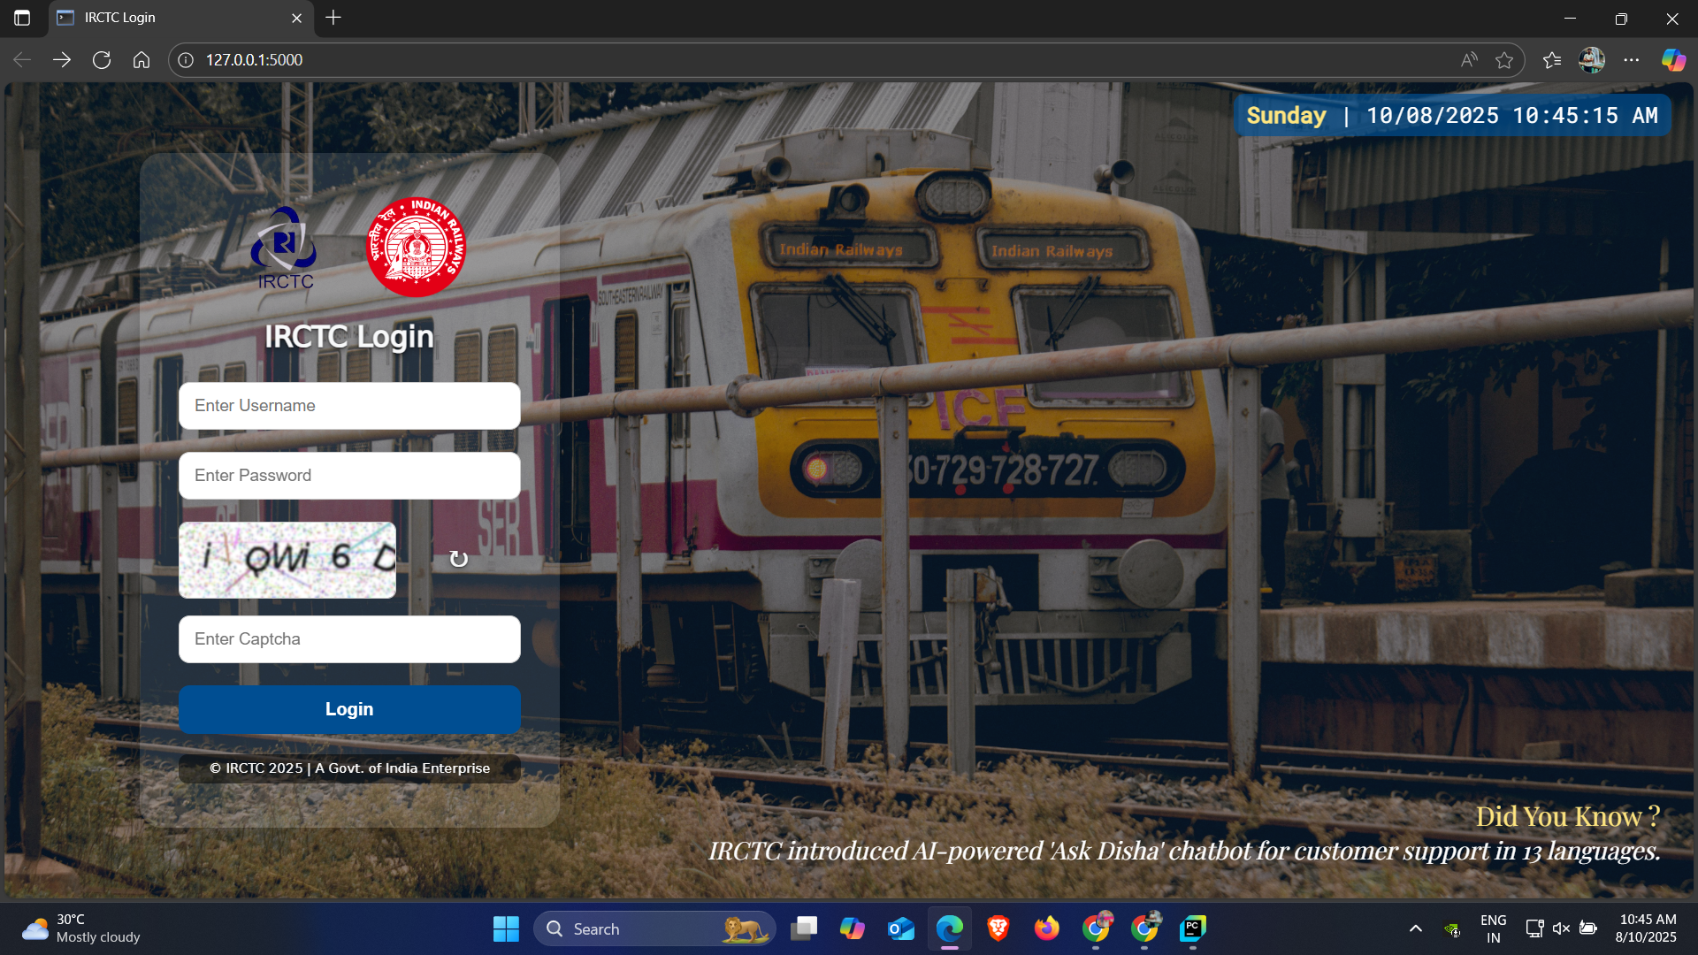
Screenshots (Login Page)

Slide 11
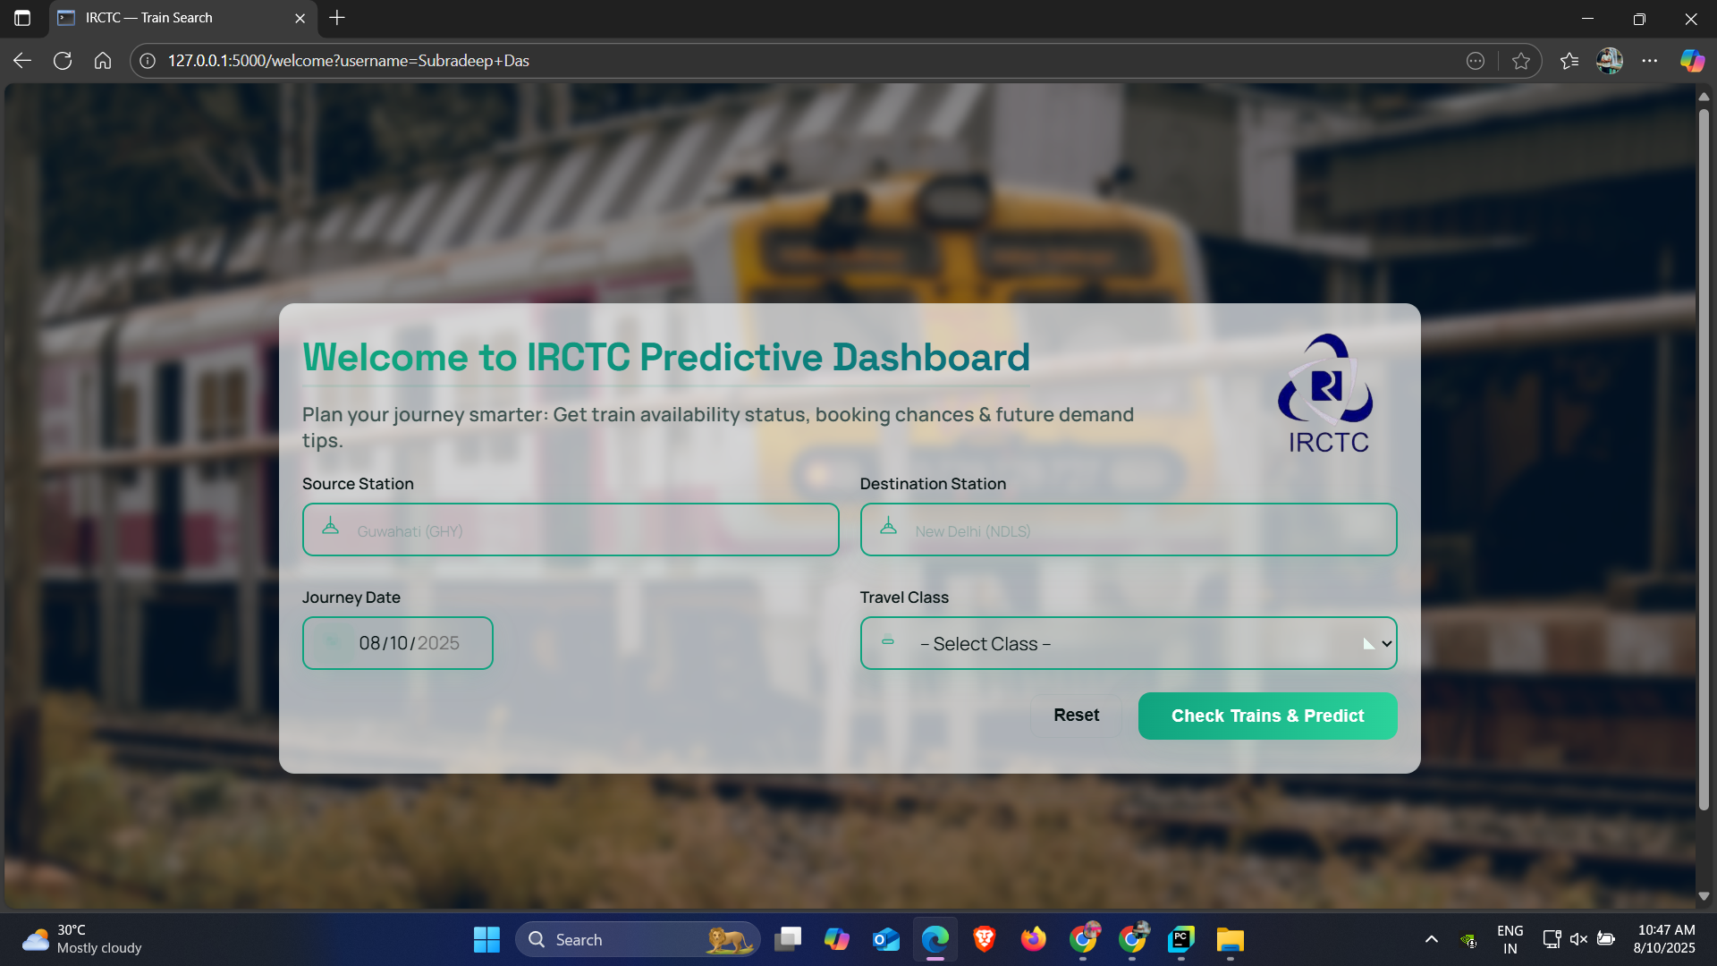
Search UI

Slide 12
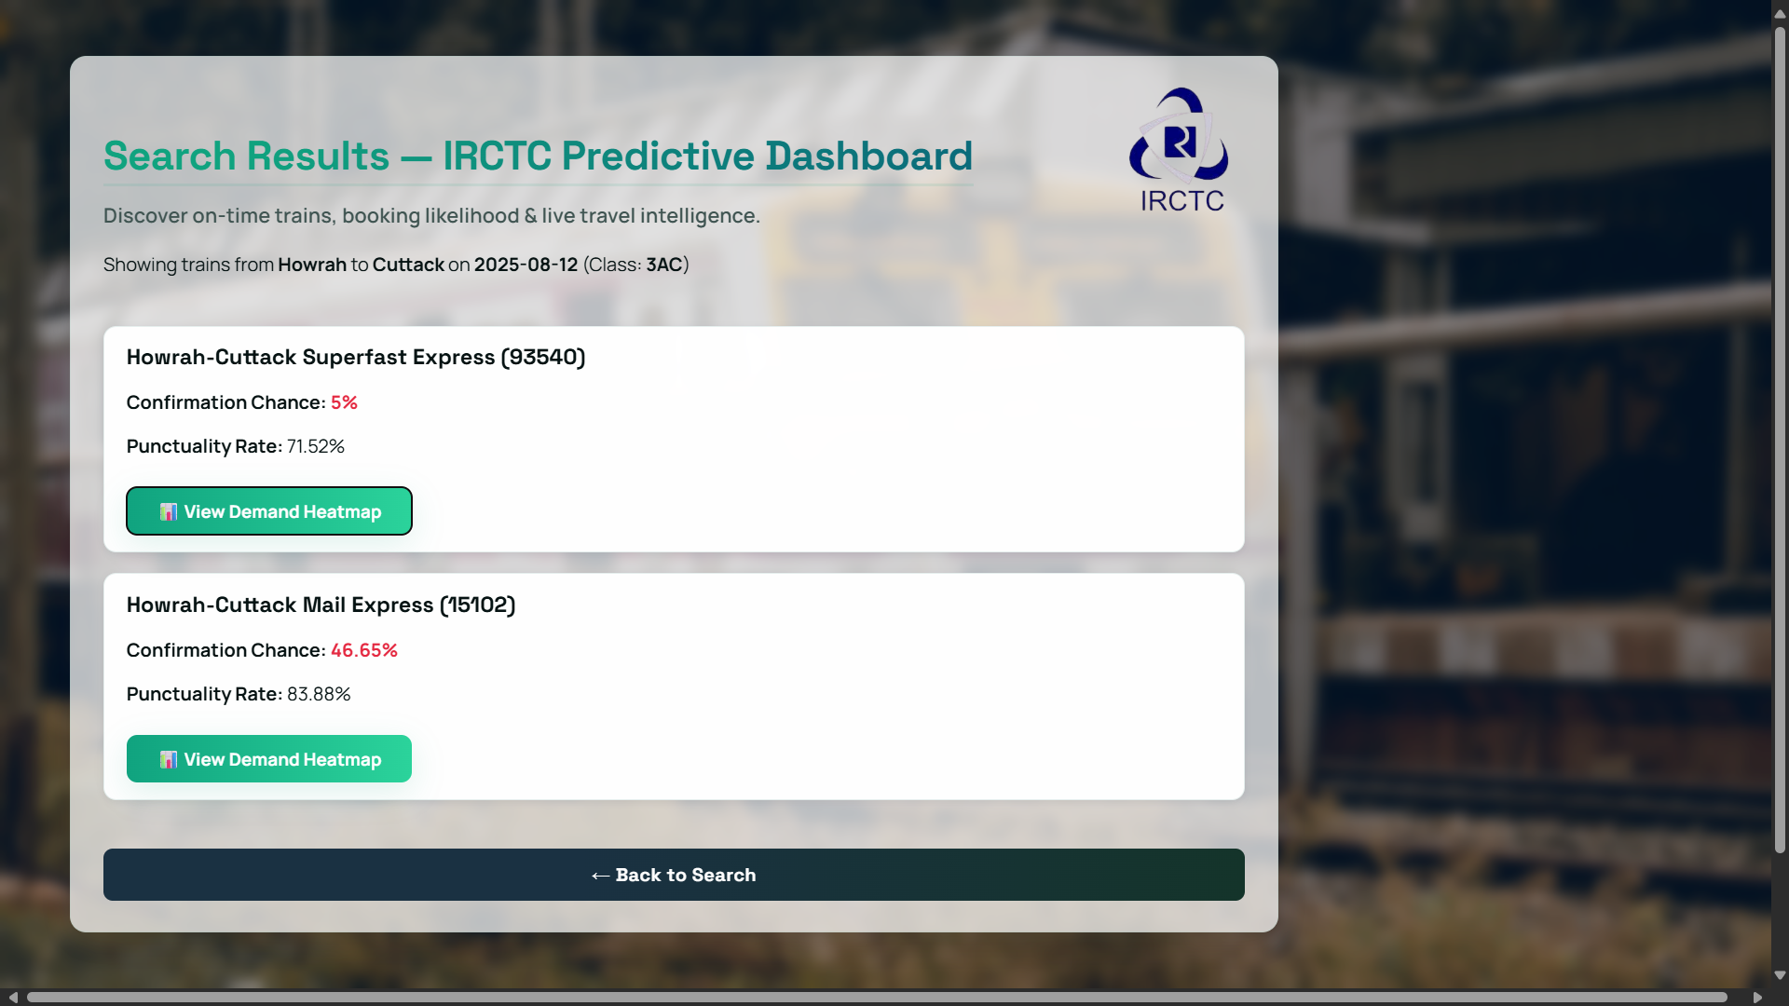
Search Results Page

Slide 13
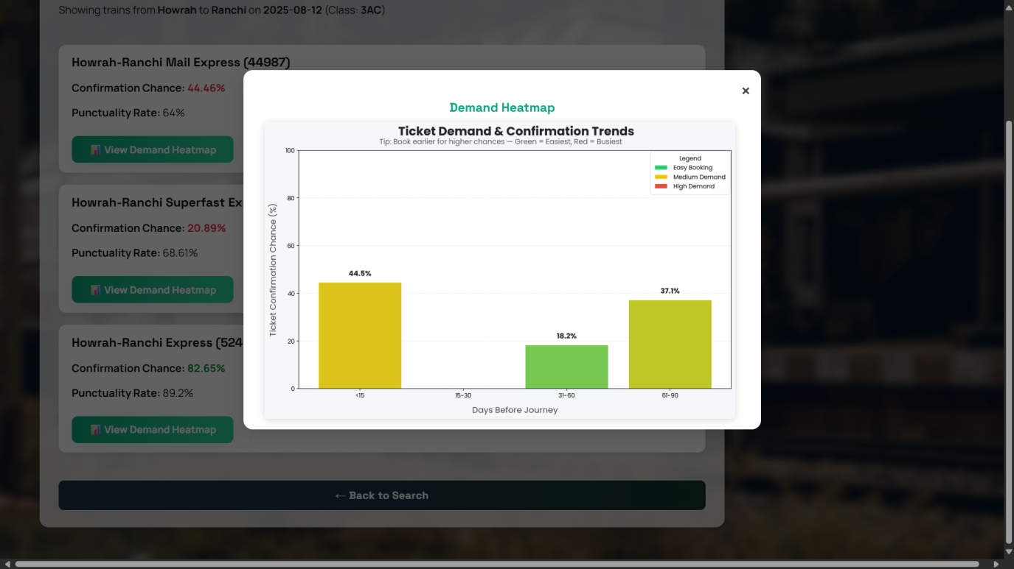
Demand Heatmap

Slide 14
Demo Steps
1) Login: CAPTCHA + behavioral telemetry capture.
2) Bot check: Keras model + hybrid rules → allow/deny + reason.
3) Train search: results returned in ~2s (p95 target).
4) Insights: punctuality badges, demand cues, calibrated confirmation odds.
5) Admin: logs, model/scaler version, retrain trigger, rollback.

Slide 15
Challenges & Resolutions
False blocks vs security: tune threshold with class weighting; optimize F1 under FP cap; add human-challenge budget.
Feature variability/noise: winsorize/outlier caps, z-score standardization, per-session aggregation; drift monitors.
Performance under load: Nginx caching, HTTP/2, tuned Gunicorn workers, DB/CSV indexing and connection pooling.
Model drift & ops: policy‑gated retraining, versioned artifacts, canary/rollback; acceptance gates (val loss↓, AUC/Brier/ECE↑/↓).
Observability: structured logs, latency histograms (p50/p95), reason codes, calibration curves.
Abuse adaptation: rotating CAPTCHA styles, rate limits, IP/device fingerprint backoff.

Slide 16
Outcomes
Bot defense: Hybrid CAPTCHA + behavioral signals cut automated access with low human friction.
Latency: Median search <2 s at 50–100 users; p95 < Z s.
Prediction quality: ROC‑AUC = A, Brier = B; reliable calibration curve.
Ops readiness: Admin visibility, retraining with acceptance tests, versioned artifacts and backups; rollback <5 min.

Slide 17
Limitations
Seasonal/holiday drift can skew behavior and demand signals.
Advanced bots may mimic human patterns over time.
Limited historical data for waitlist/punctuality proxies constrains calibration.
No live IRCTC APIs or OTP/2FA integration in current scope.

Slide 18
Future Work
Seasonality: event/holiday-aware features; richer calendar encoding.
Temporal models: sequence modeling for behavior; TensorFlow Serving for online inference.
Experimentation: A/B tests, canary deploys, shadow inference.
Product/ops: Multilingual UI, OTP for high‑risk flows, better demand data sources.

Slide 19
Conclusion
Delivered: hybrid human verification + demand‑aware search with calibrated confirmation odds.
Emphasis: low latency, explainability, privacy, deployability.
Learnings: end‑to‑end ML systems, calibration, MLOps policies, UX trade‑offs.
So we got “Improved fairness and user trust during Tatkal peaks.”

Slide 20
References
CAPTCHAs and behavioral biometrics literature
1) Von Ahn et al., “CAPTCHA: Using Hard AI Problems for Security” (original concept)
2) Bours, “Continuous Authentication by Analysis of Keystroke Dynamics” (behavioral biometrics)
3) Google reCAPTCHA / hCaptcha docs (implementation patterns and risks)
RF calibration resources; Flask/TensorFlow/scikit-learn docs
1) Probability calibration: Niculescu-Mizil & Caruana (Platt/Isotonic), scikit-learn CalibrationCurve, Brier score/ECE references.
2) Flask docs (sessions, security flags)
3) TensorFlow/Keras (Sequential models, callbacks, saving/loading)
4) scikit-learn (StandardScaler, train_test_split)

Slide 21
Thank You

